Slide 1



Solar-Boost Finance
By Team B

Slide 2







Our Team
Claire Hawks
Ella McCoy
Drake Hagerman
Hey Cheuk Lo
Peter Krivacka
Brett Soeka
Kyle Cardwell
Notes:
Ella- MArketing and sales

Slide 3
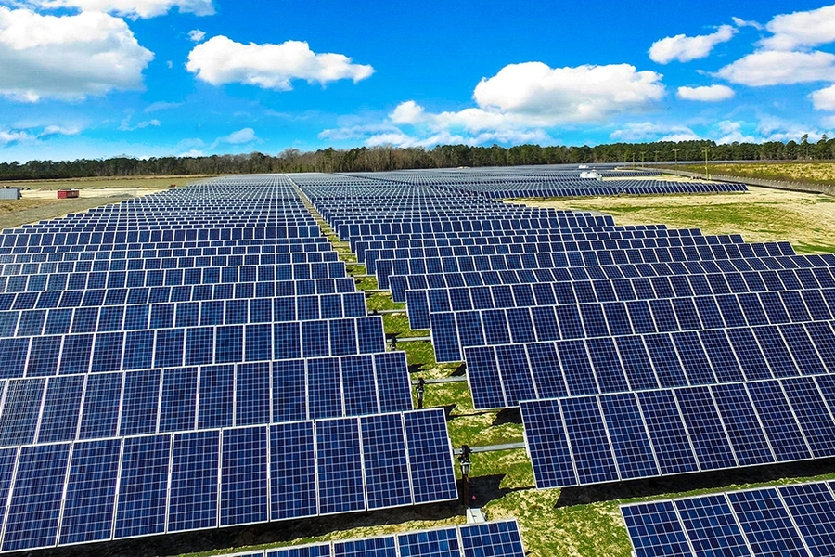
Overview
01
02
03
04
05
06
07
Intro to Our Idea
Our Company
Our Market/Revenues
Software
Competitors
Plan to Sell
Conclusion

Slide 4
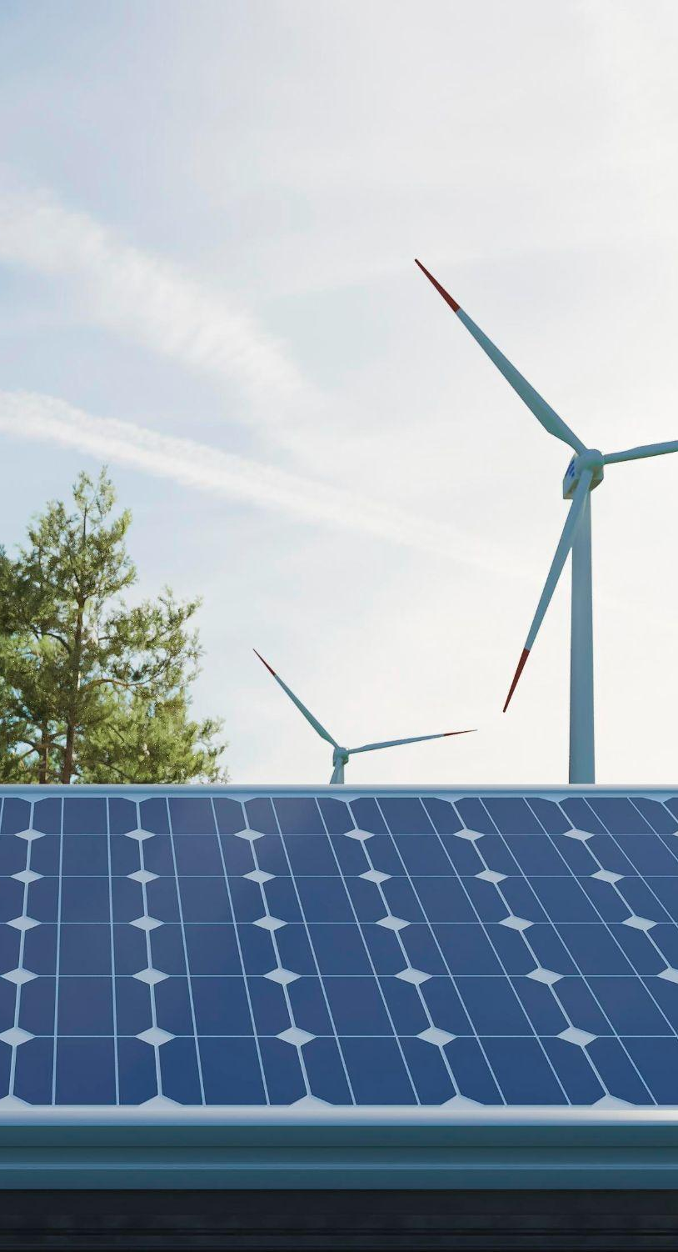
Frameset of market
Reasons for our company
Not enough big businesses invested in solar energy
-Percentage requirement from government
Government incentive
-Financial incentives with getting invested
-Big Benefits in California
Solar panels are expensive
-Getting a whole solar field for an individual company is time consuming and expensive
-Acquiring suitable land, securing permits, and addressing environmental concerns can be challenging for new entrants

Slide 5
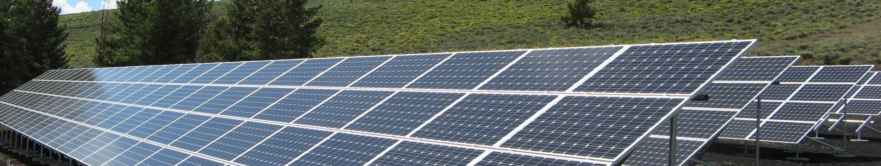
Statistics of Frameset
Reasons to invest | Government push for 50% of all energy needs to be clean by 2035
Benefits of investing | Investment Tax Credit (ITC) - tax credit equal to 30% of the cost of a solar panel system Production Tax Credit (PTC)- is a 2.6 ¢ per kilowatt-hour (kWh) tax credit for electricity generated by solar
Why California | In the last 4 years only a 2.7% increase is renewable energy usage Going solar in California can save hundreds of thousands, sometimes millions in reduced power bills.
Investment Cost | A 1 MW solar farm costs $800,000-$1,000,000
Notes:
Ella- get more stats for frameset market and the desirability for solar panels

Slide 6
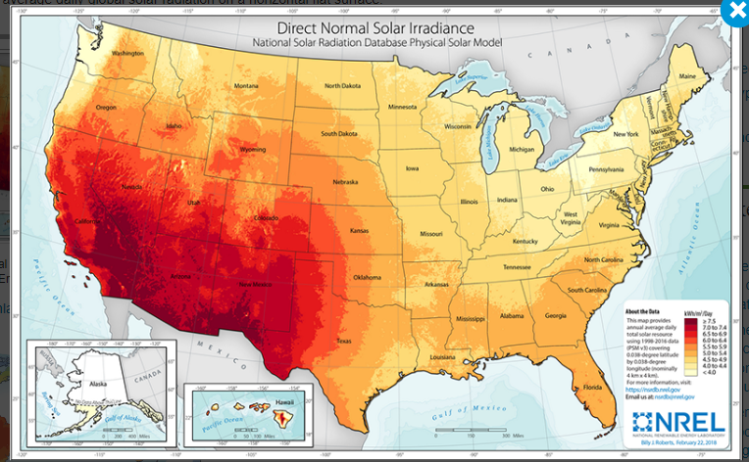

Slide 7
Our idea
Install Solar Fields
Sell energy to companies
Based on the amount of energy used, charge a percentage of the companies’ renewable energy tax benefits

Slide 8

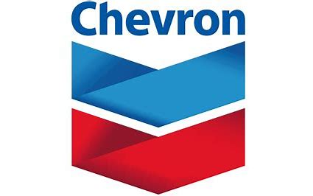
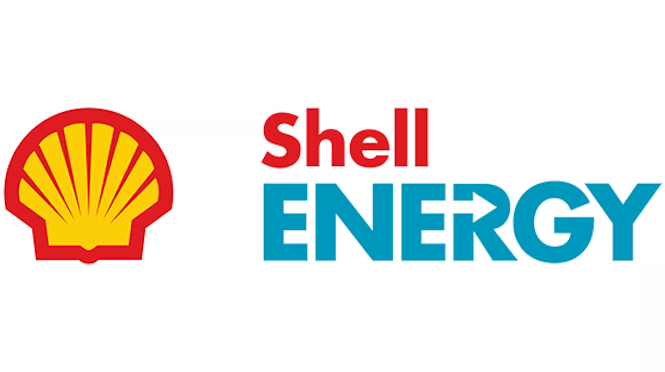
Partnership
GE Digital (San Ramon, CA) - Subsidiary of American energy conglomerate GE Vernova; the company specializes in providing software and industrial internet to industrial companies
Chevron Corporation (San Ramon, CA) - The second largest integrated energy company headquartered in the US. Continue to strive to create affordable, reliable and ever-cleaner energy.
Shell Energy (Offices all throughout California) - Provide energy to businesses that are tailored with energy products to meet sustainability needs.
Notes:
List out a few potential companies that would invest in us
Put a dollarin and get more than a dollar out
Pitching the revenue model correctly

Slide 9
Flow of money
Venture Investment
S-B Finance
Solar Fields
S-B acquires initial investment to pay for land and solar panels from venture capitalists.
S-B finance uses this money to buy land, finance solar panels, and install solar fields.
Solar fields are installed on California land for use by companies.
Solar Fields
Customers
S-B Finance
Solar fields provide energy to customers in the amount they buy it.
Customers use energy from solar fields to power their manufacturing operations, and receive tax credits on using solar power.
Customers pay S-B finance for energy, and S-B Finance takes a percentage of the tax credits the company receives.

Slide 10
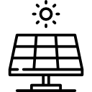
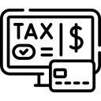
Revenue and ROI
Selling solar energy to companies
Capitalizing on ITC and PTC tax credits
$45,000+ annually per 1 MW solar farm
$18,000+ annually
$300 million+ total
revenue opportunities
Initial Investment: $1,000,000 for a 1 MW solar field
Present Value of Revenue Streams and Deductions: $1,850,000
Present Value of Costs: $363,555
Total Return on Investment: $486,000 (48% ROI)

Slide 11
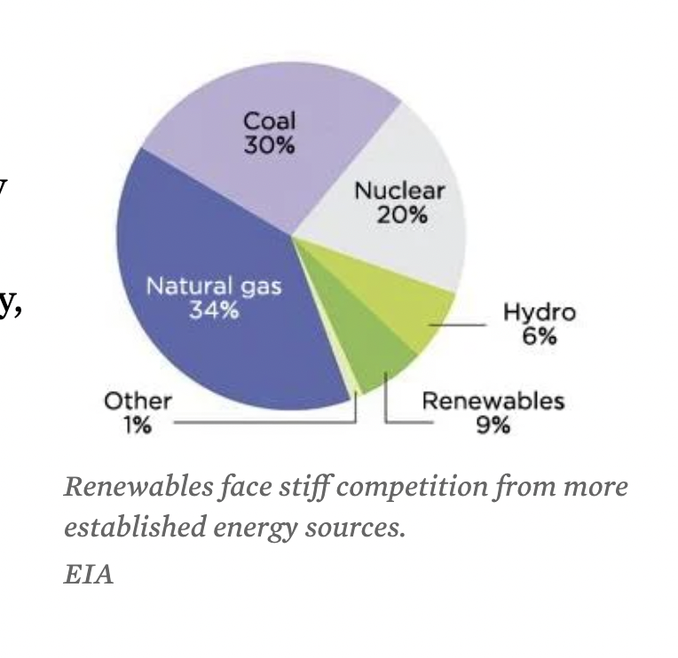
Competitor
Current Competition
Their Strategies
Why we are different
Duke Energy
Prologis
Owns power generating facilities and produces their own energy
Has transmission lines to help sell electricity to large communities
Take the global supply chain's energy to solar-powered facilities to cut energy costs
Duke energy operates in east coast and part of midwest
S-B Energy supplies energy to southwest side of sunbelt
More sunlight generates more solar energy, more to sell back, can afford to be cheaper

Slide 12
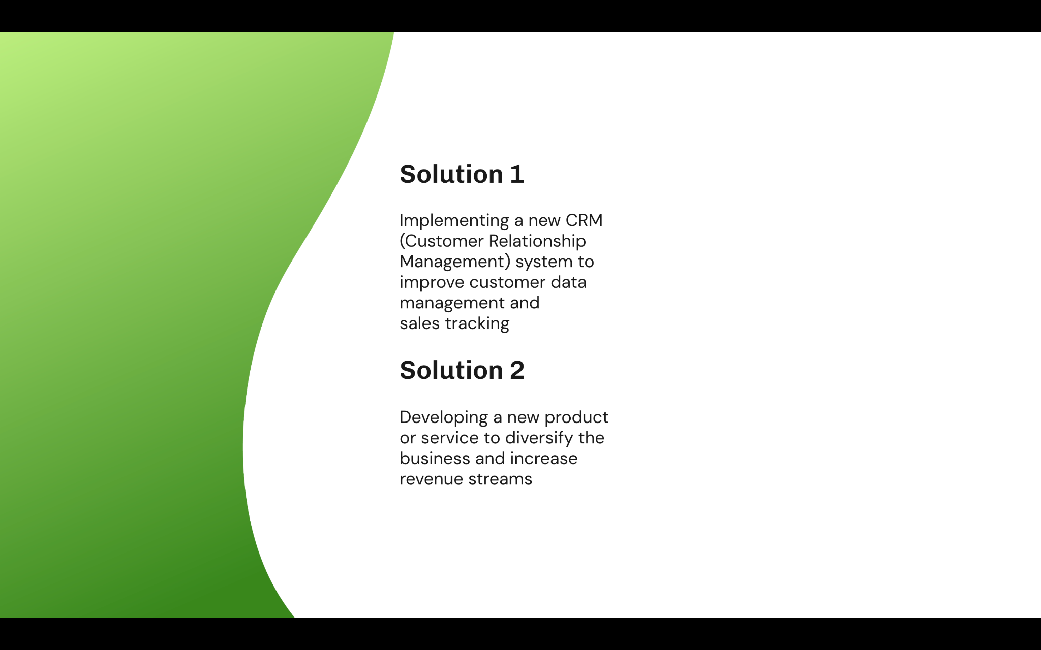
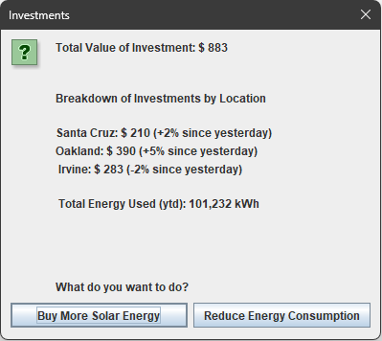
Our Software
Demo

Slide 13
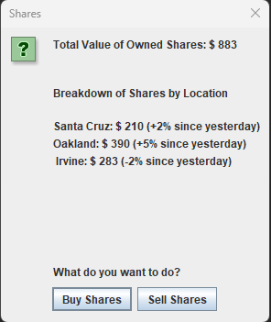
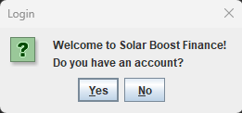
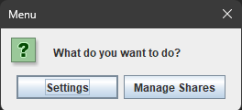
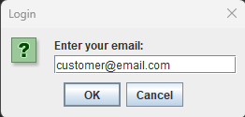
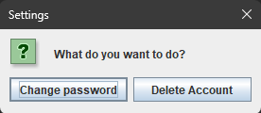
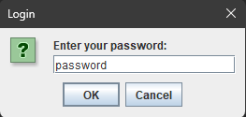
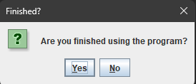
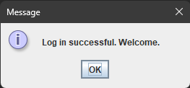
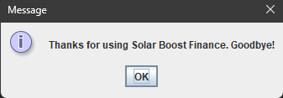

Slide 14
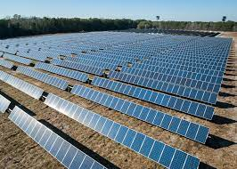

Initial Target Audience
We are targeting large manufacturers in California
Produce and consume exponentially more energy than residents
Incentives to meet clean energy requirements and tax benefits
They have the resources to invest on a large scale
Notes:
Customer profile and different target audiences- ella

Slide 15
Our Strategy to Sell
Online selling
Education on Benefits
Curate our online marketing strategies towards large manufacturing profiles. Ensure that there are resources and promotions online is key for visibility.
Using renewable energy on a large-scale has many benefits for the environment, meeting renewable energy standards for companies, and benefits from the government.
Cold Call Representatives
Solar Energy Partnership
Target companies will be identified and directly contacted to be given information about S-B Energy and given an opportunity to set up a consultation meeting.
This strategy will allow us to gain credibility and trust with these larger companies. We will collaborate with them to ensure best use of land and solar panels.
Notes:
Partner with big solar energy companies to gain trusts and credibility and also help with solar panel stuff we have tpo deal with

Slide 16
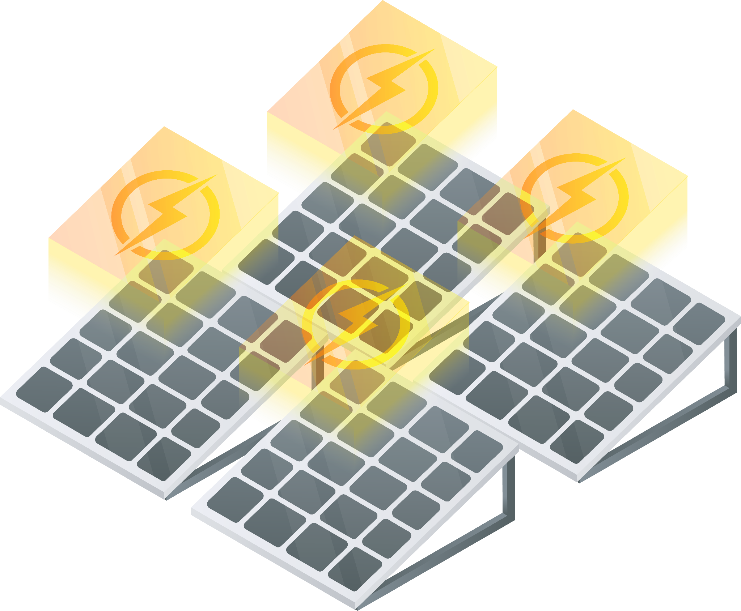
Solar-Boost Finance
We will provide energy to the United States’ largest manufacturers through the solar fields we build.
Why we choose to do it
Increased demand in solar energy
Big corporations and manufacturing plants requires huge energy sources to run
High incentives for utilization of solar energy
Could save them ~$250,000 annually by having a 1 MW solar farm
Solar energy accounted for 53% of all new electricity-generating capacity added to the U.S. grid in 2023.

Slide 17



Growth Potential
Scaling up the size of solar farm
Expanding to new locations across the sunbelt
Finding more business to collaborate with and potentially house owners

Slide 18
Thank you!

Slide 19
https://www.energy.gov/eere/solar/federal-solar-tax-credits-businesses#:~:text=A%20solar%20PV%20property%20that,reduces%20tax%20liability%20by%20%24300%2C000.
https://thundersaidenergy.com/downloads/industrial-energy-and-electricity-consumption-by-sector/

Slide 20

Company Objectives
Our aim
The goal
To simplify the transition to solar energy for large corporations, providing an efficient, hassle-free solution that ensures autonomy and sustainability in their energy use.
To expand our renewable energy solutions across the nation
Enhancing accessibility to solar power for homes and businesses alike.

